Slide 1
SECURE AND DATA ACCESS CONTROL FOR CLOUD STORAGE
Under the Guidance of:
Mrs. A.M. SERMAKANI
Team Members:
ARUN PRASAD V
EZHILARASAN E
JASWANTH B
Date: 28-03-2023
Domain: CLOUD

Slide 2
ABSTRACT
Data owners will store their data in public cloud along with encryption and particular set of attributes to access control on the cloud data. Cloud owners have all rights to download and delete their data whenever they want. While uploading the data into public cloud they will assign some attribute set to their data.
If any authorized cloud user wants to download their data they should enter that particular attribute set to perform further actions on data owner’s data. A cloud user wants to register their details under cloud organization to access the data owner’s data.
Users want to submit their details as attributes along with their designation. Based on the user details Semi-Trusted Authority generates decryption keys to get control on owner’s data. An user can perform a lot of operations over the cloud data. If the user wants to read or write the cloud data he needs to be entering some read or write operations related attributes.

Slide 3
LITERATURE SURVEY
Project Title: Cloud data integrity checking with an identity-based auditing mechanism from RSA.
Author Name: Yong Yua, Liang Xuea, Man Ho Aub, Willy Susilo, Jianbing Ni, Yafang Zhanga, Athanasios V. Vasilakos, Jian Shene.
Year of publishing: 2016
Project Title: ENCRYPTED DATA MANAGEMENT WITH DEDUPLICATION IN CLOUD COMPUTING
Author Name: TRUPTI RONGARE
Year of publishing: 2016

Slide 4
Project Title: Leveraging software defined networking for security policy enforcement
Author Name: iaqiangLiu,YongLi,HuandongWang, DepengJin, LiSu, LieguangZeng, ThanosVasilakos
Year of publishing: 2015
Project Title: SeDaSC: Secure Data Sharing in Clouds
Author Name: Mazhar Ali, Revathi Dhamotharan Eraj Khan, Samee U. Khan, Athanasios V. Vasilakos Keqin Li, Albert Y. Zomaya
Year of publishing: 2015
Project Title: Security and Privacy for Storage and Computation in Cloud Computing
Author Name: K. Sharmila1, V. Vinoth Kumar
Year of publishing: 2014

Slide 5
Project Title: Large Universe Ciphertext-Policy Attribute-Based Encryption with White-Box
Traceability
Author Name: Jianting Ning, Zhenfu Cao, Xiaolei Dong, Lifei Wei, and Xiaodong Lin
Year of publishing: 2014
Project Title: Attribute Based Data Sharing with Attribute Revocation
Author Name: Shucheng, YuCong Wang, Kui Ren
Year of publishing: 2010
Project Title: Expressive, Efficient and Revocable Data Access Control for Multi-Authority Cloud Storage
Author Name: Chetan Bulla Akshata R. Patil, Priyanka B. Guttedar and Reshma G. Giddenavar
Year of publishing: 2016

Slide 6
Project Title: CryptCloud+: Secure and Expressive Data Access Control for Cloud Storage
Author Name: Jianting Ning, Zhenfu Cao, Xiaolei Dong, Kaitai Liang
Year of publishing: 2018
Project Title: CryptCloud Secure and Expressive Data Access Control for Cloud Storage
Author Name: John Justin, Sybi Cynthia, Rohith Viswanathan G
Year of publishing: 2019

Slide 7









SYSTEM ARCHITECTURE
STA
Data Owners
Data owners have all rights to delete and edit their data
Public Cloud
File Permission Key
Generates Attribute based decryption keys
File Upload
Cloud Users
Encrypt Files
Registration & Login
Enter Decryption key
Policy File Creation
File permission key
Informs to Data Owners
Key Leakage
True User
Account Blocked
File Read, Write, Download, Delete

Slide 8
LIST OF MODULES
Organization profile creation & Key Generation
Data Owners File Upload
File Permission & Policy File Creation
Tracing who is guilty

Slide 9
MODULE DESCRIPTION
1. Organization profile creation & Key Generation
User has an initial level Registration Process at the web end. The users provide their own personal information for this process. The server in turn stores the information in its database. Now the Accountable STA (semi-trusted Authority) generates decryption keys to the users based on their Attributes Set (e.g. name, mail-id, contact number etc..,). User gets the provenance to access the Organization data after getting decryption keys from Accountable STA.
2. Data Owners File Upload
In this module data owners create their accounts under the public cloud and upload their data into public cloud. While uploading the files into public cloud data owners will encrypt their data using RSA Encryption algorithm and generates public key and secret key. And also generates one unique file access permission key for the users under the organization to access their data.

Slide 10
3. File Permission & Policy File Creation
Different data owners will generate different file permission keys to their files and issues those keys to users under the organization to access their files. And also generates policy files to their data that who can access their data. Policy File will split the key for read the file, write the file, download the file and delete the file.
4. Tracing who is guilty
Authorized DUs are able to access (e.g. read, write, download, delete and decrypt) the outsourced data. Senior Employees have all the permission to access the files (read, write, delete, & download). Fresher’s only having the permission to read the files. Some Employees have the permission to read and write. And some employees have all the permissions except delete the data. If any Senior Employee leaks or shares their secret permission keys to their junior they will request to download or delete the Data Owners Data. While entering the key system will generate attribute set for their role in background validate that the user has all rights to access the data. If the attributes set is not matched to the Data Owners policy files they will be claimed as guilty.

Slide 17
CODING
AccountabilityPojo.java
package logics;
public class AccountabilityPojo {
private String email,qustion1,answer1,question2,answer2,question3,answer3,question4,answer4,owner;
public String getOwner() {
return owner;
}
public void setOwner(String owner) {
this.owner = owner;}

Slide 18
public String getEmail() {
return email;}
public void setEmail(String email) {
this.email = email;}
public String getQustion1() {
return qustion1;}
public void setQustion1(String qustion1) {
this.qustion1 = qustion1;
}

Slide 19
public String getAnswer1() {
return answer1;
}
public void setAnswer1(String answer1) {
this.answer1 = answer1;}
public String getQuestion2() {
return question2;
}
public void setQuestion2(String question2) {
this.question2 = question2;}

Slide 20
public String getAnswer2() {
return answer2;
}
public void setAnswer2(String answer2) {
this.answer2 = answer2;
}
public String getQuestion3() {
return question3;
}

Slide 21
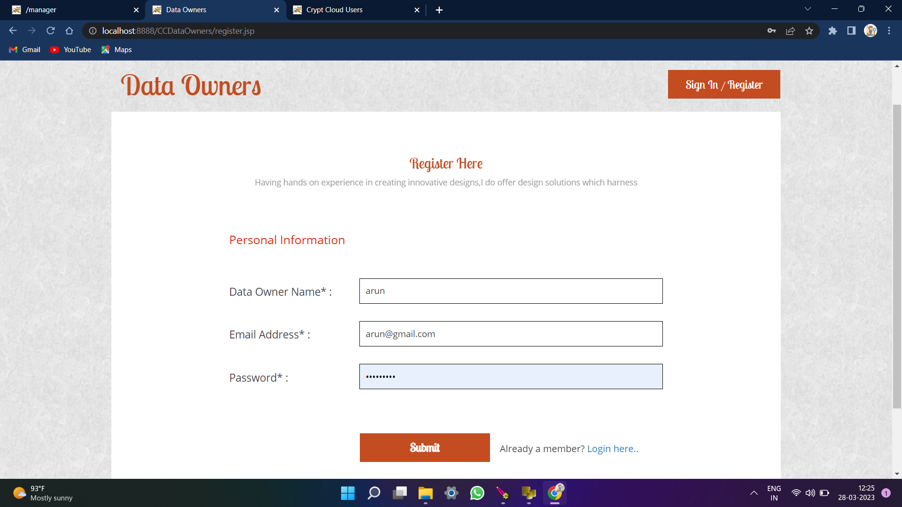
SCREEN SHOTS
Profile Creation

Slide 22
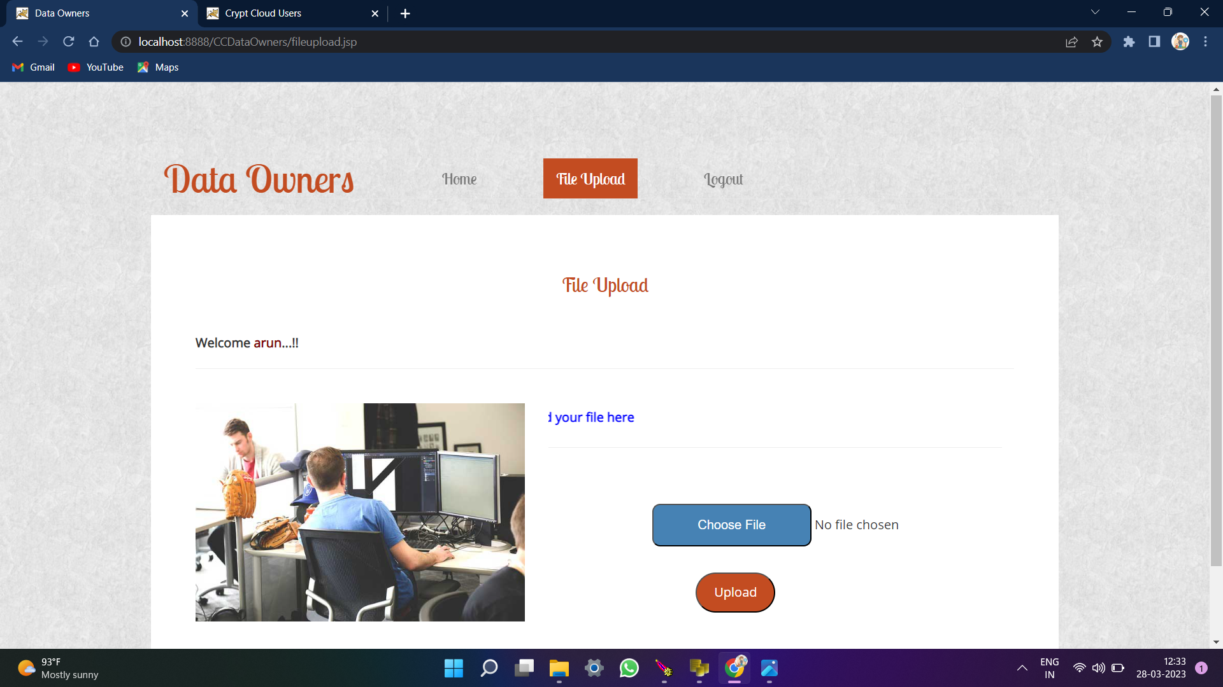
DATA OWNERS FILE UPLOAD

Slide 23
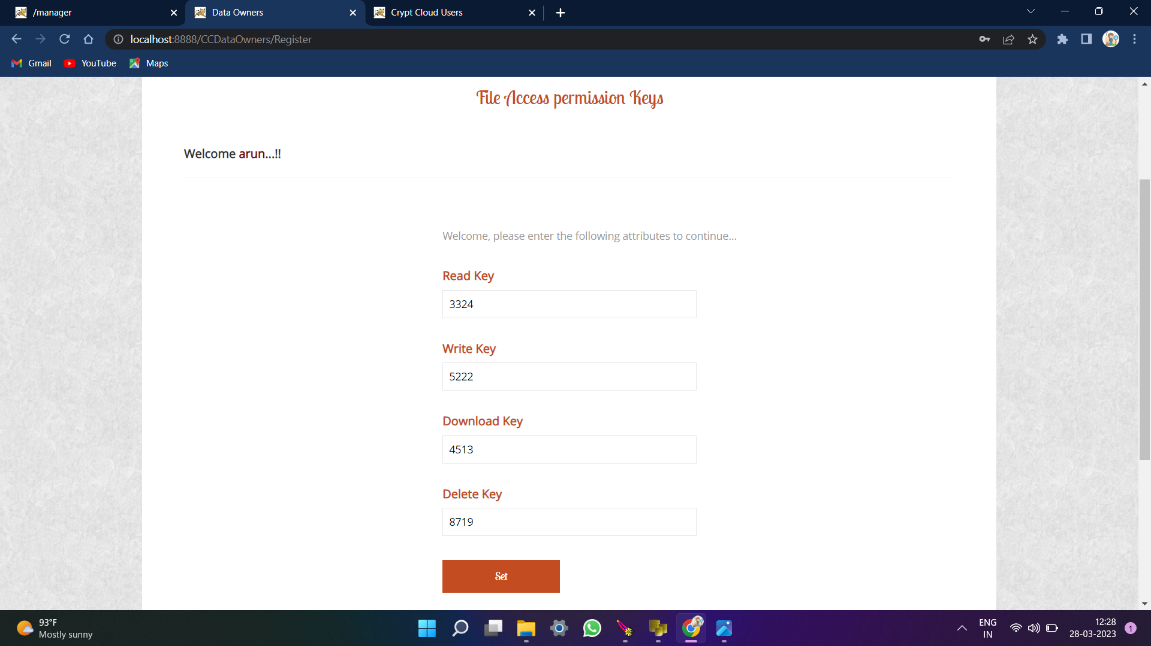
FILE PERMISSION

Slide 24
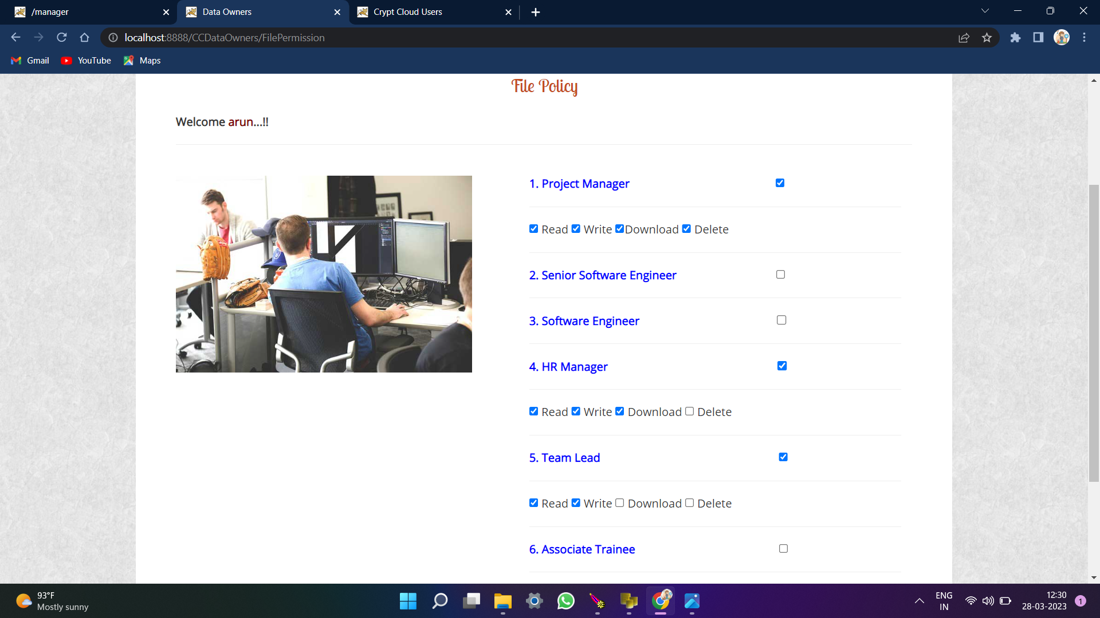
FILE POLICY

Slide 25
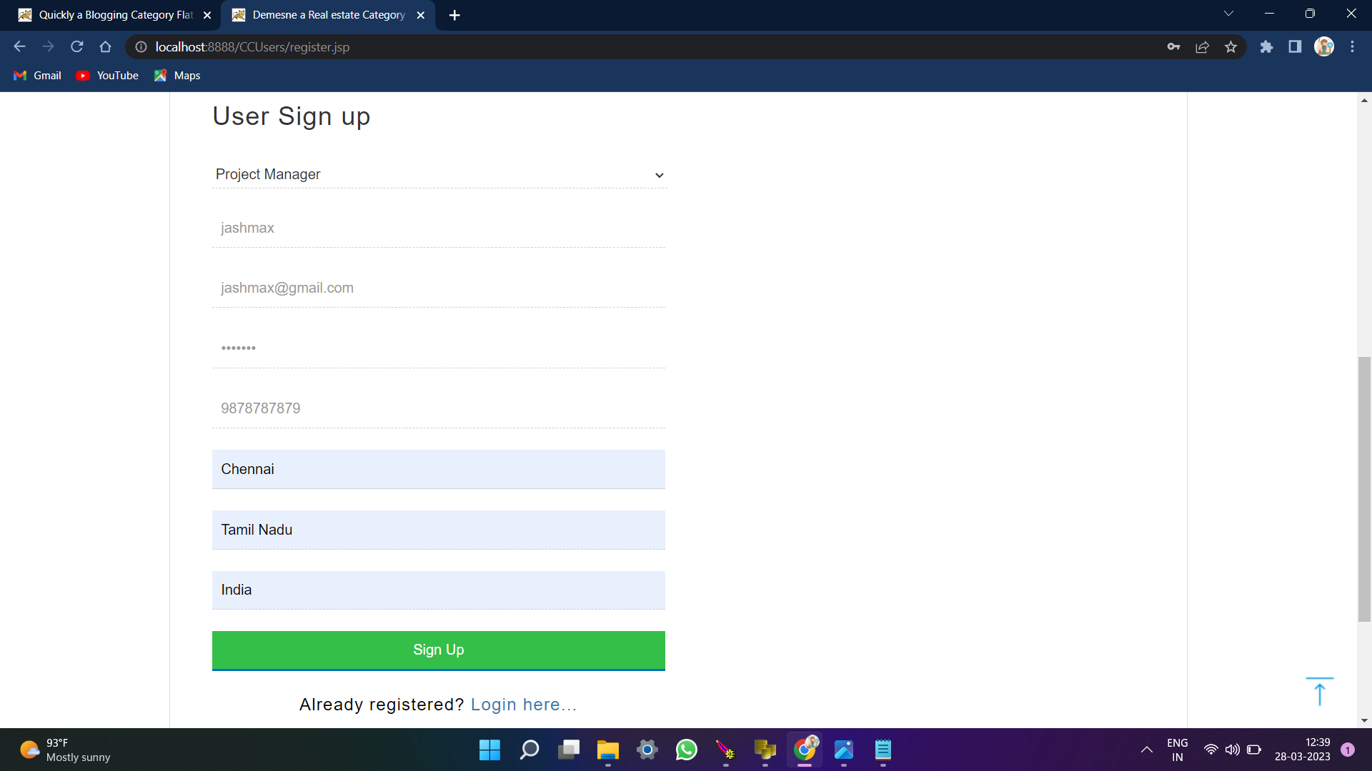
USER SIGNUP

Slide 26
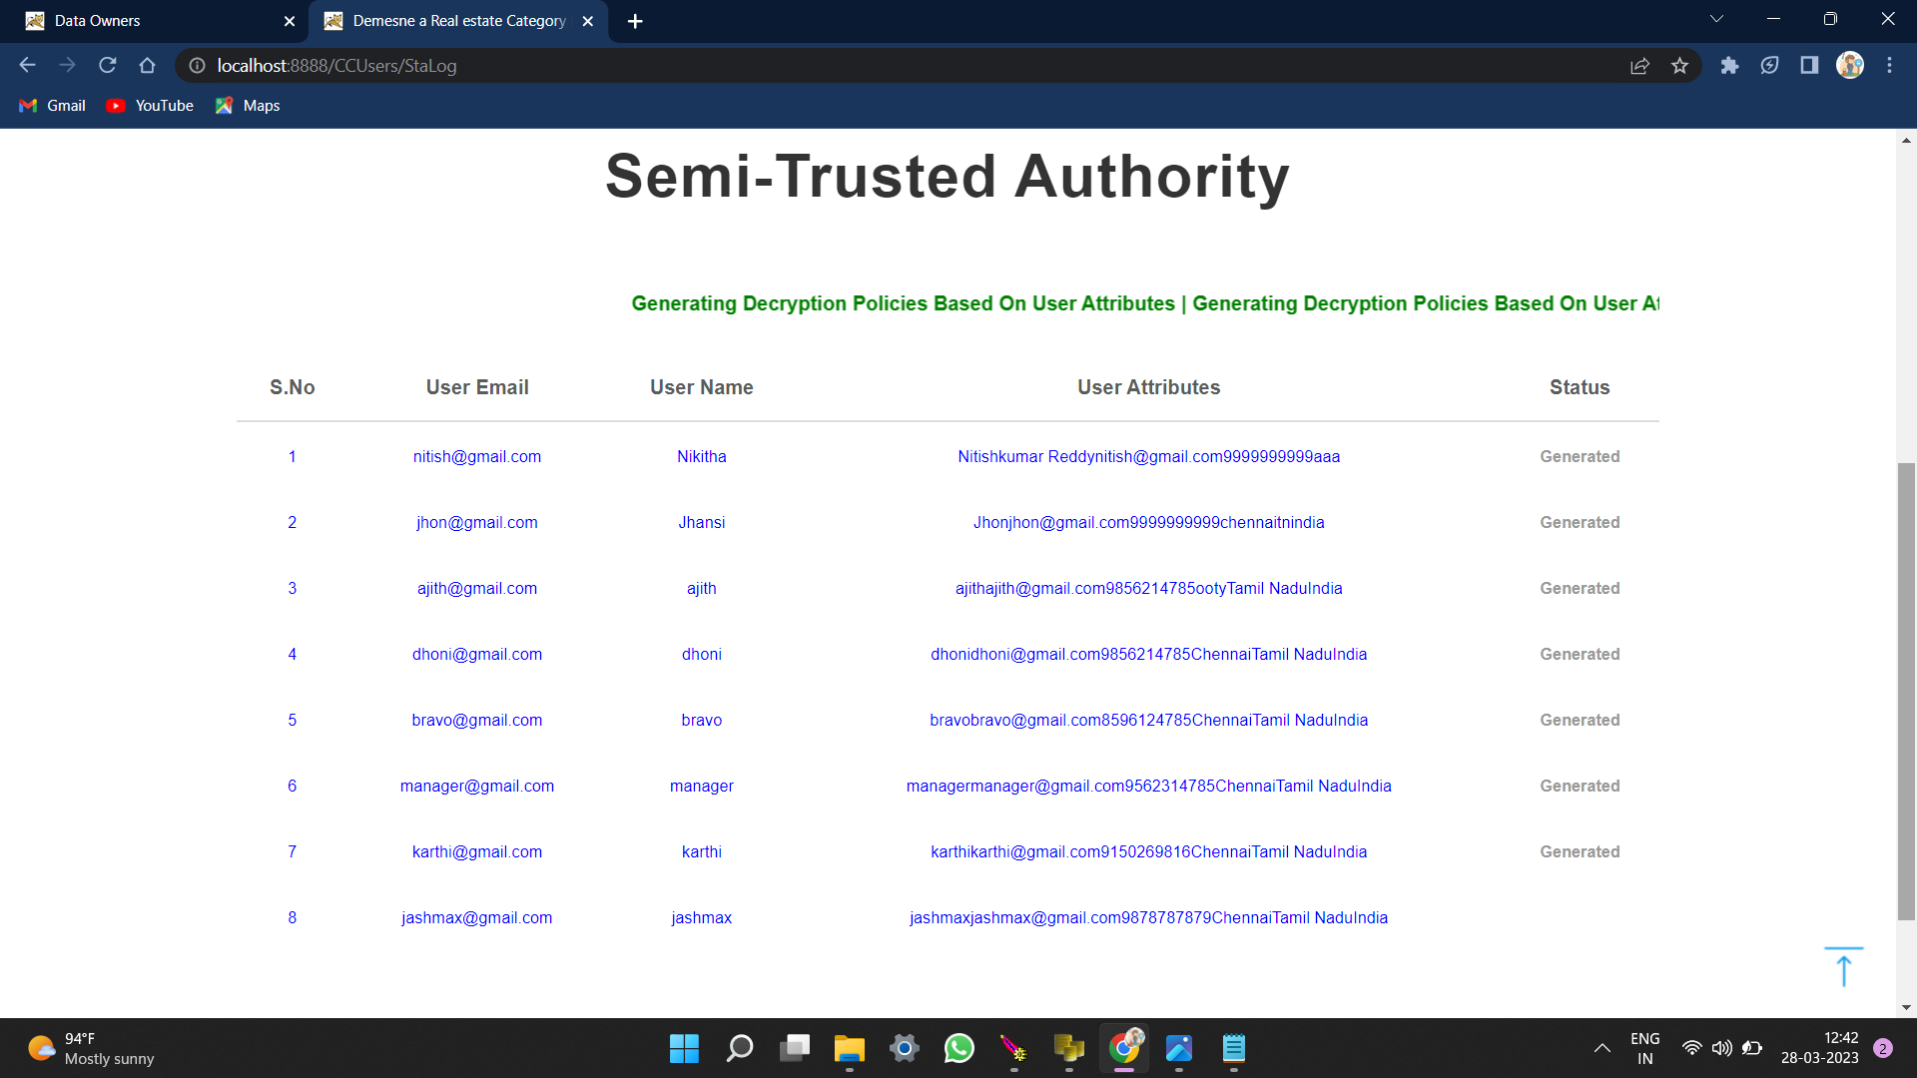
SEMI – TRUSTED AUTHORITY

Slide 27
HARDWARE AND SOFTWARE REQUIREMEWNTS
HARDWARE RECQUIREMENTS
Hard Disk : 80GB and Above
RAM : 4GB and Above
Processor: P IV and Above
SOFTWARE RECQUIREMENTS
Windows 7 and above
JDK 1.7
J2EE
Java Virtual Machine (JVM)
Tomcat 7.0
MySQL
TECHNOLOGY USED: J2EE (JSP, Servlets), JavaScript, HTML , CSS, AJAX.

Slide 28


